Slide 1
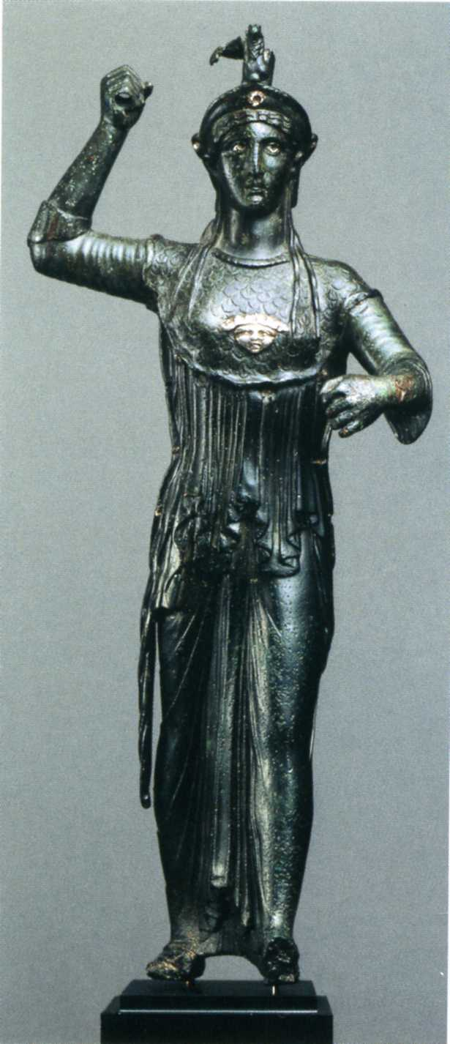
Retrospective Styles in Hellenistic and Roman Art: terminology and interpretation
C.H. Hallett
Classical Art Research Center: October 1st 2015
Replicas in Roman Art: Redeeming the Copy?

Slide 2
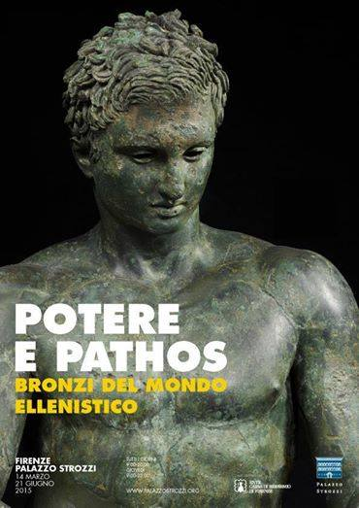
Retrospective Styles in Hellenistic and Roman Art: terminology and interpretation
C.H. Hallett

Slide 3
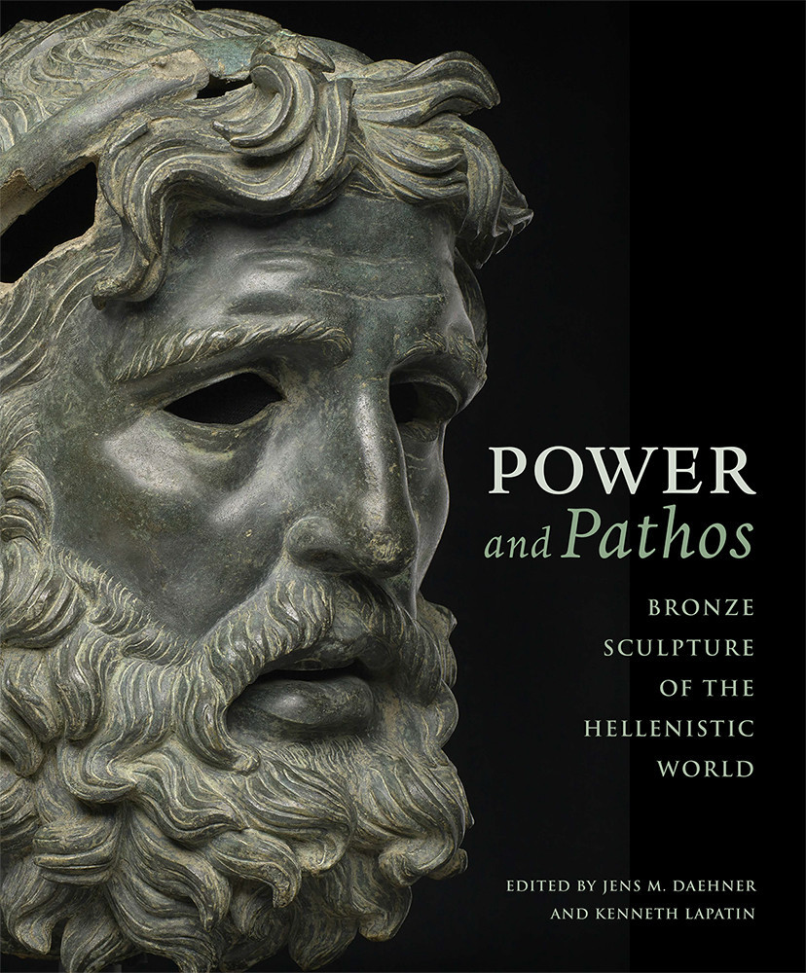
Retrospective Styles in Hellenistic and Roman Art: terminology and interpretation
C.H. Hallett

Slide 4
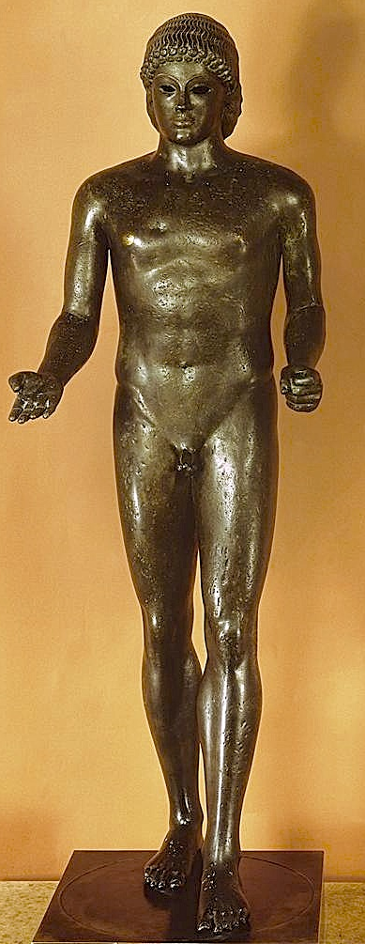
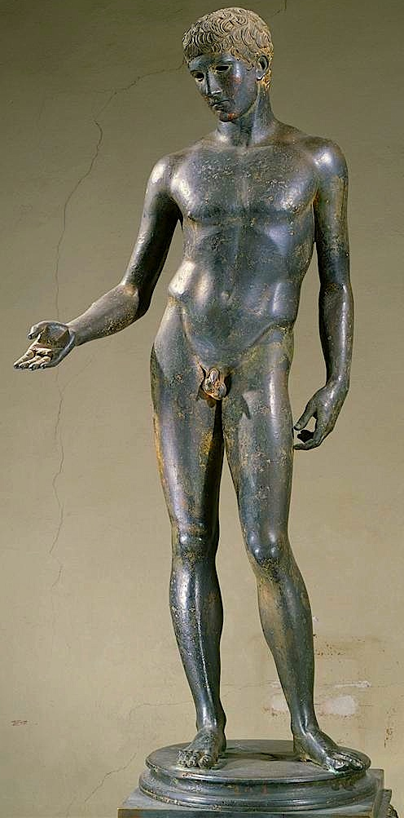
ARCHAIC AND CLASSICAL BRONZES OF THE HELLENISTIC AND ROMAN PERIOD
Apollo Piombino, in Archaic Style
2nd century BC, Paris, Louvre
Idolino, in Classical style
1st century BC – early 1st century AD Florence, Archaeological Museum

Slide 5
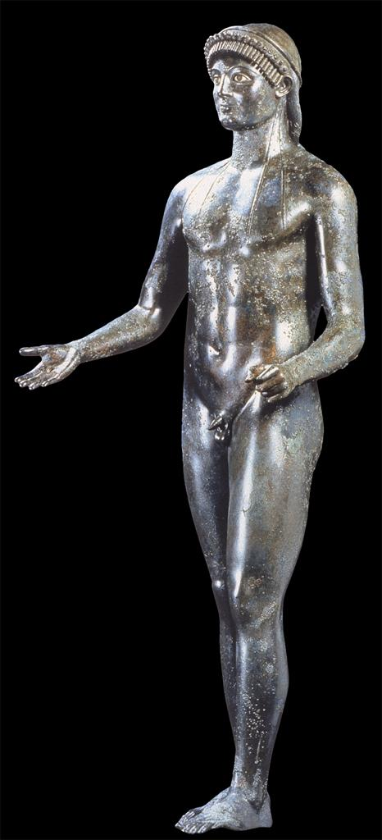
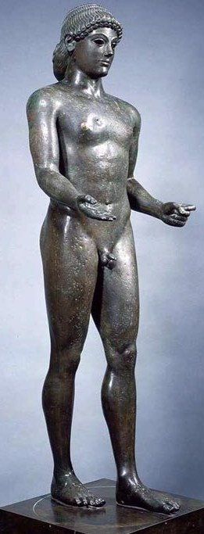
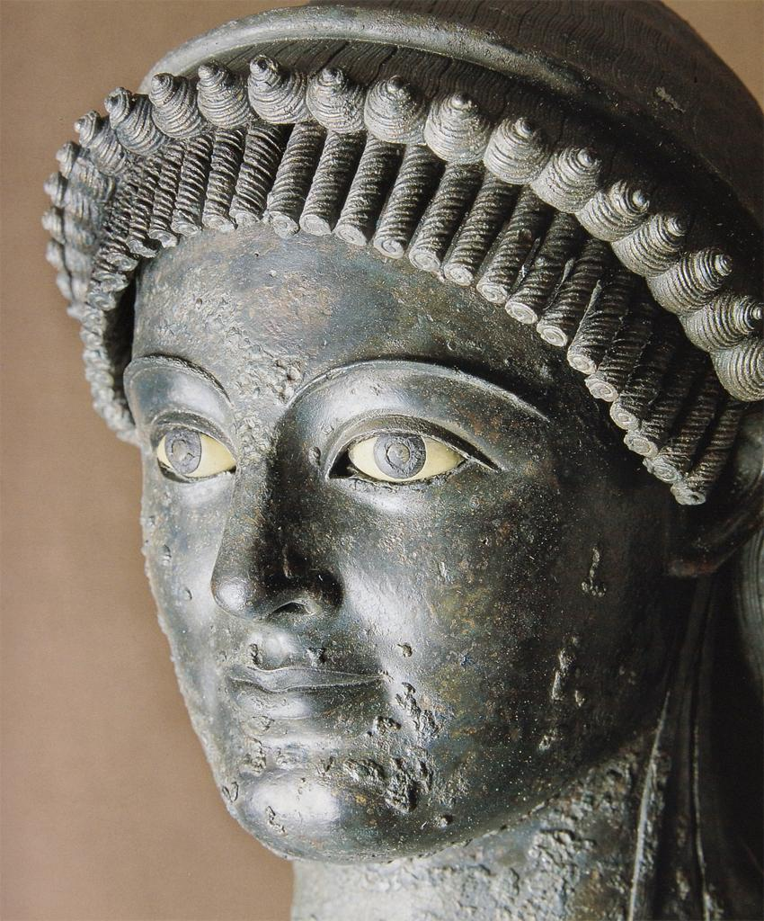
ARCHAIC AND CLASSICAL BRONZES OF THE HELLENISTIC AND ROMAN PERIOD
Apollo Piombino, in Archaic Style
2nd century BC, Paris, Louvre
Roman bronze in Archaic style from Pompeii
House of C. Julius Polybius, before AD 79
Naples Archaeological Museum

Slide 6
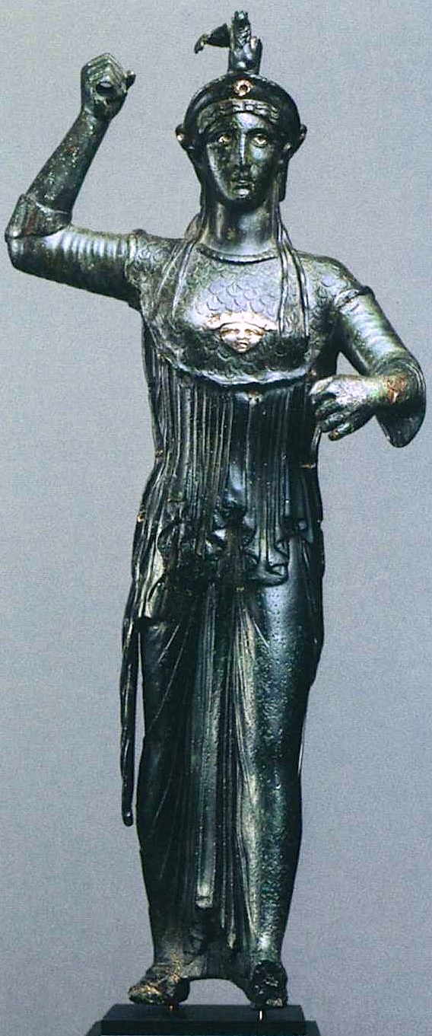
CASE STUDY 1: GETTY ATHENA
Statuette of Athena Promachos, in Archaic Style
first century BC-early first century AD; Getty Villa

Slide 7
CASE STUDY 1: GETTY ATHENA
Silver inlay on:
(1) whites of eyes
Statuette of Athena Promachos, in Archaic Style
first century BC-early first century AD; Getty Villa

Slide 8
CASE STUDY 1: GETTY ATHENA
Silver inlay on:
(1) whites of eyes
(2) attachment holes for a border of silver (?) snakes
Statuette of Athena Promachos, in Archaic Style
first century BC-early first century AD; Getty Villa

Slide 9
CASE STUDY 1: GETTY ATHENA
Silver inlay on:
(1) whites of eyes
(2) attachment holes for a border of silver (?) snakes
(3) gorgoneion on aegis
Statuette of Athena Promachos, in Archaic Style
first century BC-early first century AD; Getty Villa

Slide 10
CASE STUDY 1: GETTY ATHENA
Silver inlay on:
(1) whites of eyes
(2) attachment holes for a border of silver (?) snakes
(3) gorgoneion on aegis
(4) ornament on front of helmet
Statuette of Athena Promachos, in Archaic Style
first century BC-early first century AD; Getty Villa

Slide 11
CASE STUDY 1: GETTY ATHENA
Silver inlay on:
(1) whites of eyes
(2) attachment holes for a border of silver (?) snakes
(3) gorgoneion on aegis
(4) ornament on front of helmet
Statuette of Athena Promachos, in Archaic Style
first century BC-early first century AD; Getty Villa

Slide 12
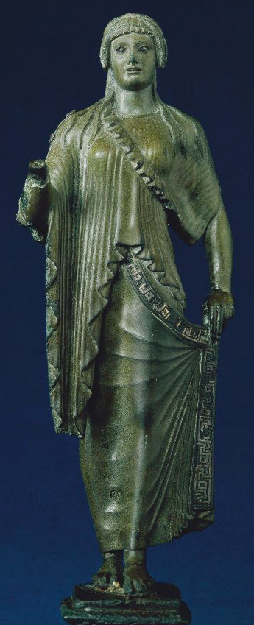
CASE STUDY 1: GETTY ATHENA
Spes Castellani, Augustan;
London, British Museum

Slide 13
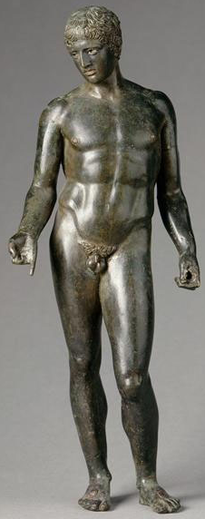
CASE STUDY 1: GETTY ATHENA
Statuette of Polykleitan “Diskophoros”
1st century BC – 1st century AD
Paris, Louvre

Slide 14
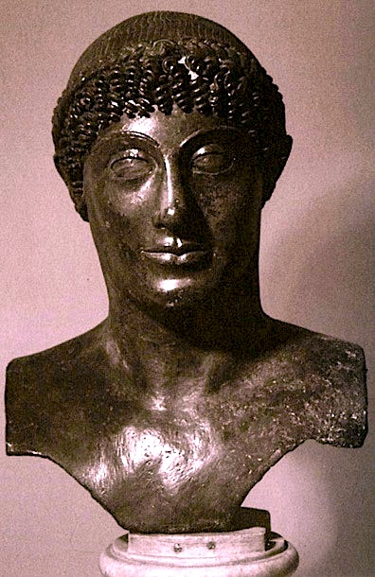
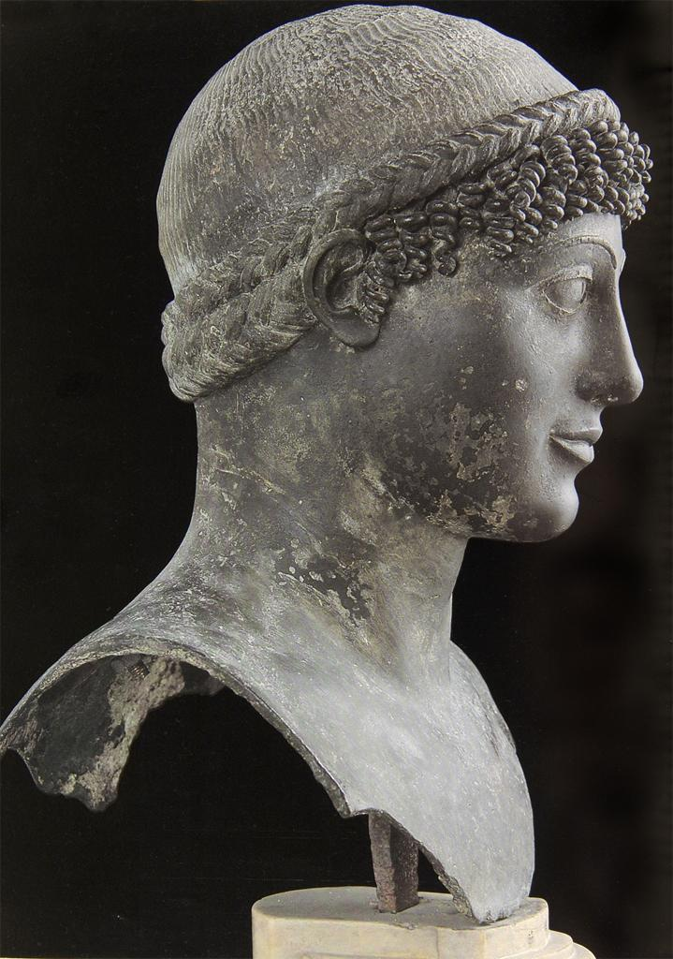
CASE STUDY 2: “THE KOUROS PISONI”
“Kouros Pisoni”; Bronze Hermapollo from the large peristyle
of the Villa dei Papiri Herculaneum; mid-first century BC
Eyes were originally inset; now filled with modern plaster Naples Archaeological Museum

Slide 15
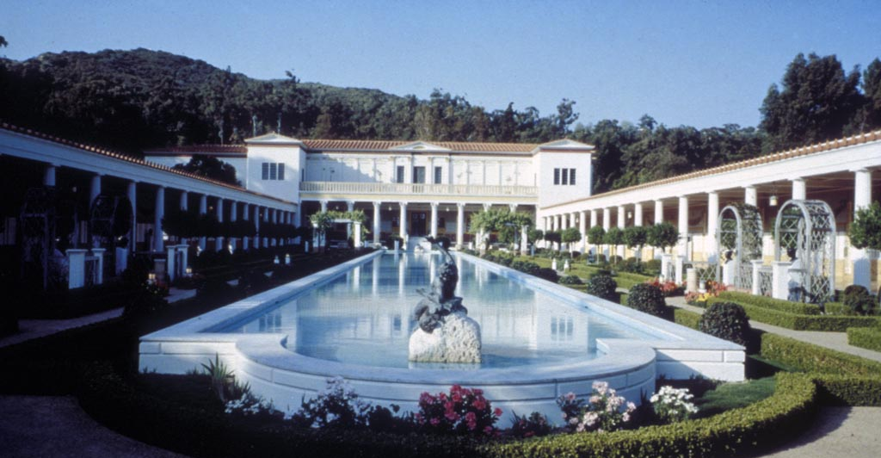
CASE STUDY 2: “THE KOUROS PISONI”
The large peristyle of the Villa dei Papiri Herculaneum, reconstructed at the J. Paul Getty Villa, Malibu
“Kouros Pisoni”; Bronze Hermapollo from the large peristyle
of the Villa dei Papiri Herculaneum; mid-first century BC
Eyes were originally inset; now filled with modern plaster Naples Archaeological Museum

Slide 16
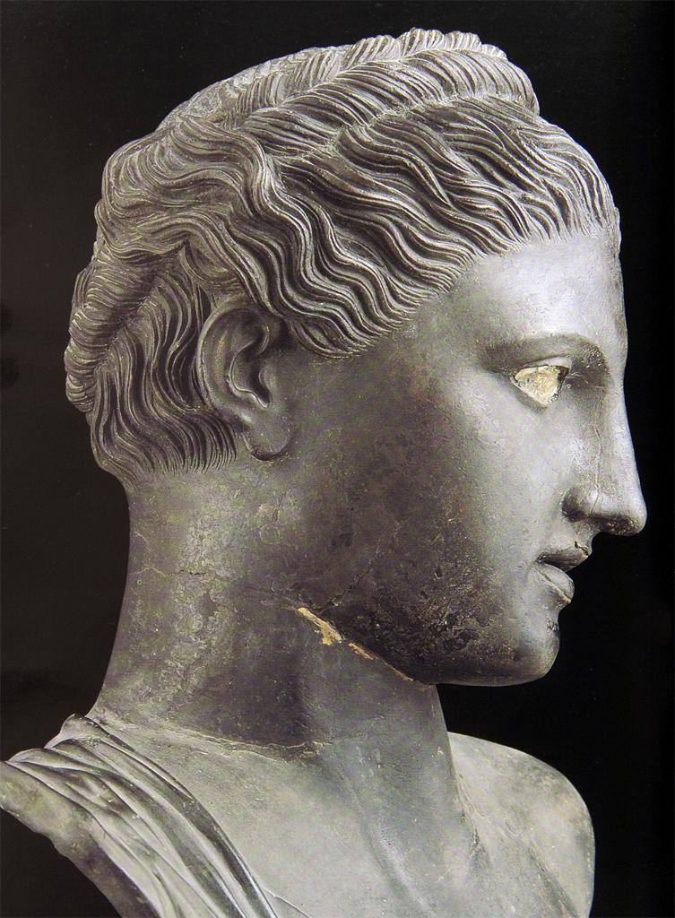
CASE STUDY 2: “THE KOUROS PISONI”
Herm bust of Artemis (?), paired with the “Hermapollo” in the large peristyle garden of the Villa of the Papyri
“Kouros Pisoni”; Bronze Hermapollo from the large peristyle
of the Villa dei Papiri Herculaneum; mid-first century BC
Eyes were originally inset; now filled with modern plaster Naples Archaeological Museum

Slide 17
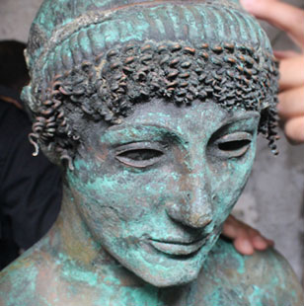
CASE STUDY 2: “THE KOUROS PISONI”
Apollo from Gaza; allegedly dredged out of the sea in August 2013 by a local fisherman.
“Kouros Pisoni”; Bronze Hermapollo from the large peristyle
of the Villa dei Papiri Herculaneum; mid-first century BC
Eyes were originally inset; now filled with modern plaster Naples Archaeological Museum

Slide 18
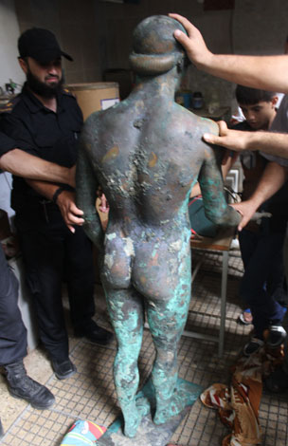
CASE STUDY 2: “THE KOUROS PISONI”
Apollo from Gaza; allegedly dredged out of the sea in August 2013 by a local fisherman.

Slide 19
CASE STUDY 2: “THE KOUROS PISONI”
Apollo from Gaza; allegedly dredged out of the sea in August 2013 by a local fisherman.
“Kouros Pisoni”; Bronze Hermapollo from the large peristyle
of the Villa dei Papiri Herculaneum; mid-first century BC
Eyes were originally inset; now filled with modern plaster Naples Archaeological Museum

Slide 20
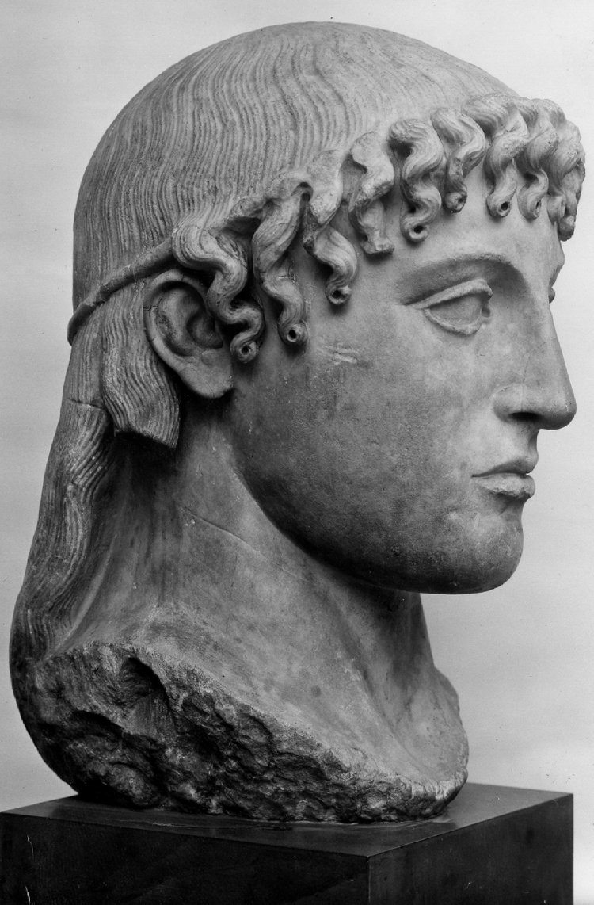
CASE STUDY 2: “THE KOUROS PISONI”
The “Townley Apollo”; Roman marble copy of a
Greek bronze of the early 5th century BC (?)

Slide 21
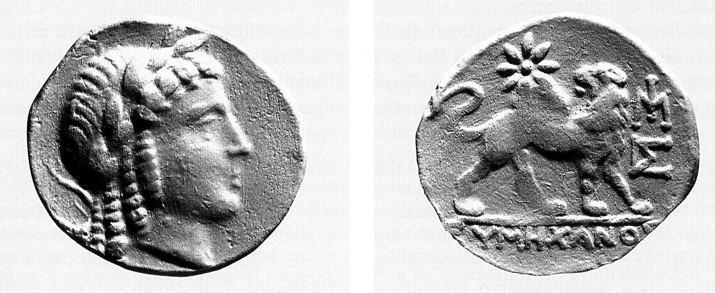
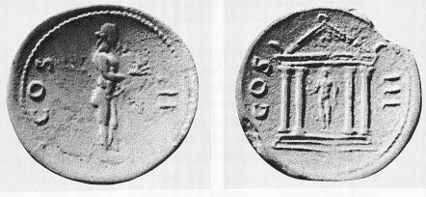
CASE STUDY 2: “THE KOUROS PISONI”
Milesian gold coin with the head of Kanachos’ bronze cult image of Apollo Didymeus at Didyma; ca. 200 BC
Hadrianic cistophoroi showing the same statue
The “Townley Apollo”; Roman marble copy of a
Greek bronze of the early 5th century BC (?)

Slide 22
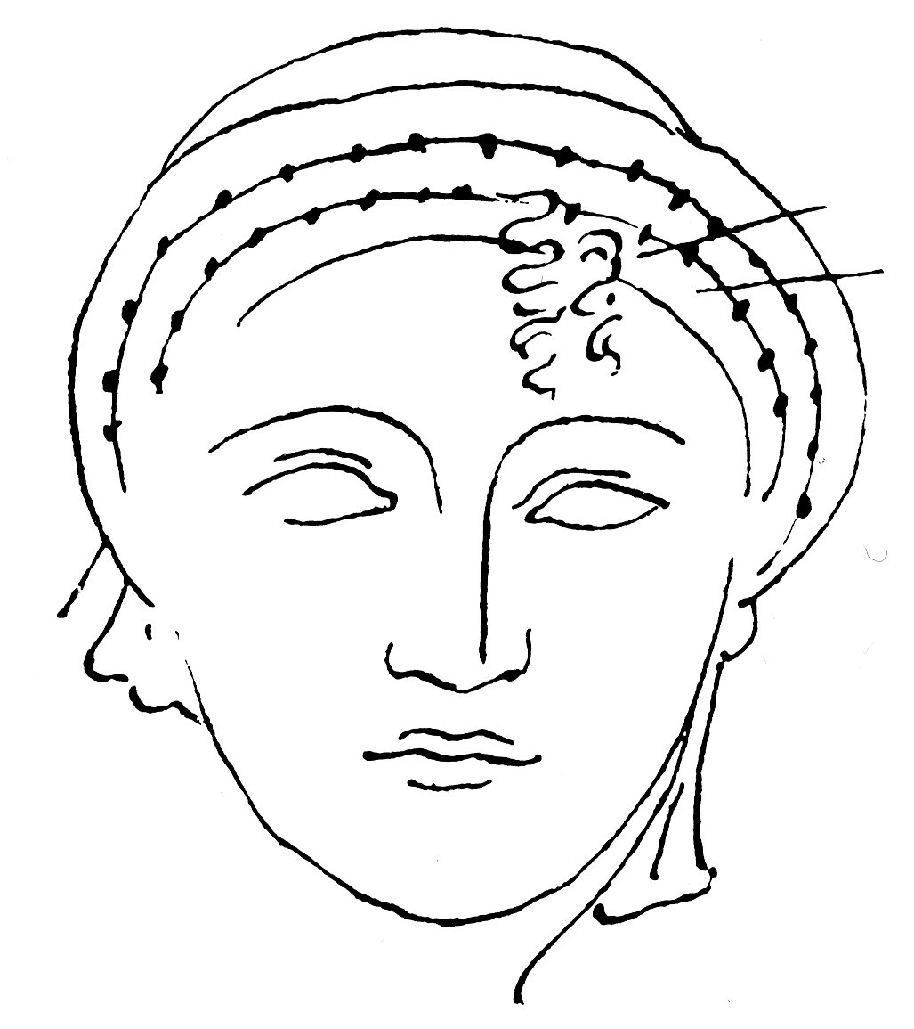
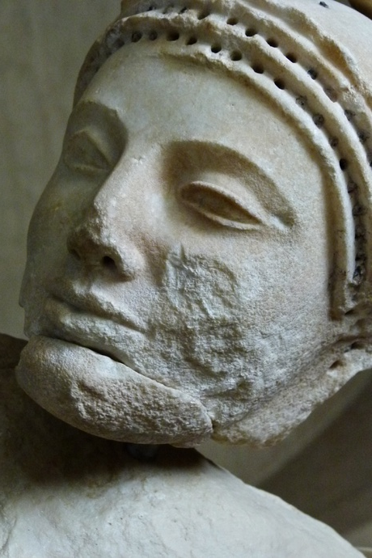
CASE STUDY 2: “THE KOUROS PISONI”
Early 5th century BC marble head from the east pediment of the temple of Aphaia on Aegina
Same head with 2 lead-wire curls from the fringe still in place (as drawn by Cockerell)

Slide 23
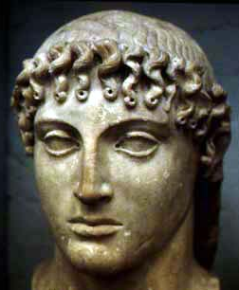
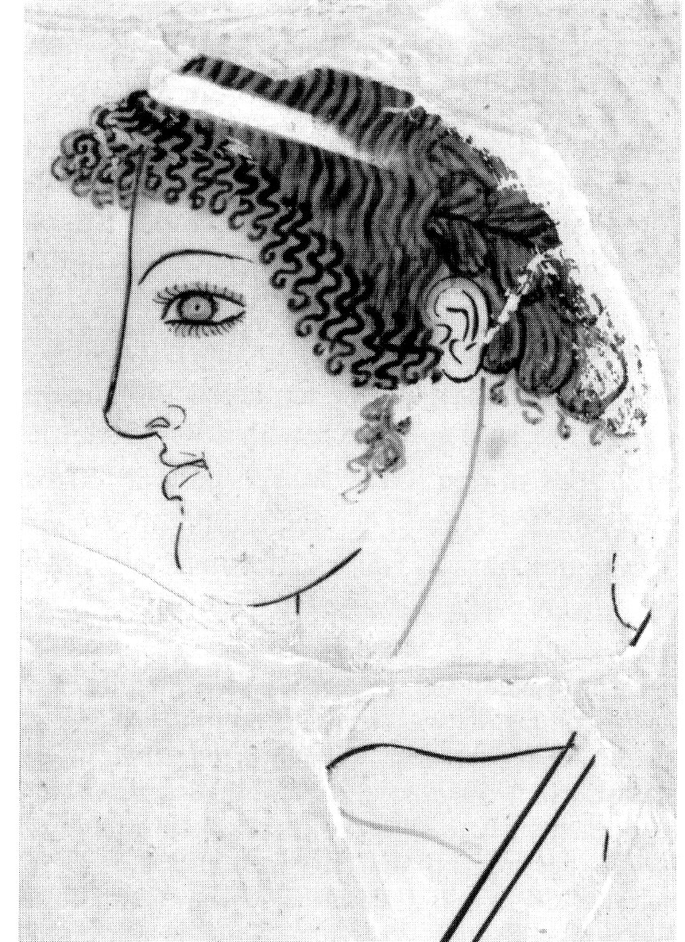
CASE STUDY 2: “THE KOUROS PISONI”
The “Townley Apollo”; Roman marble copy
of a Greek bronze of the early 5th century BC
Detail of head of Achilles with long fringe
from an Early 5th century painted pot

Slide 24
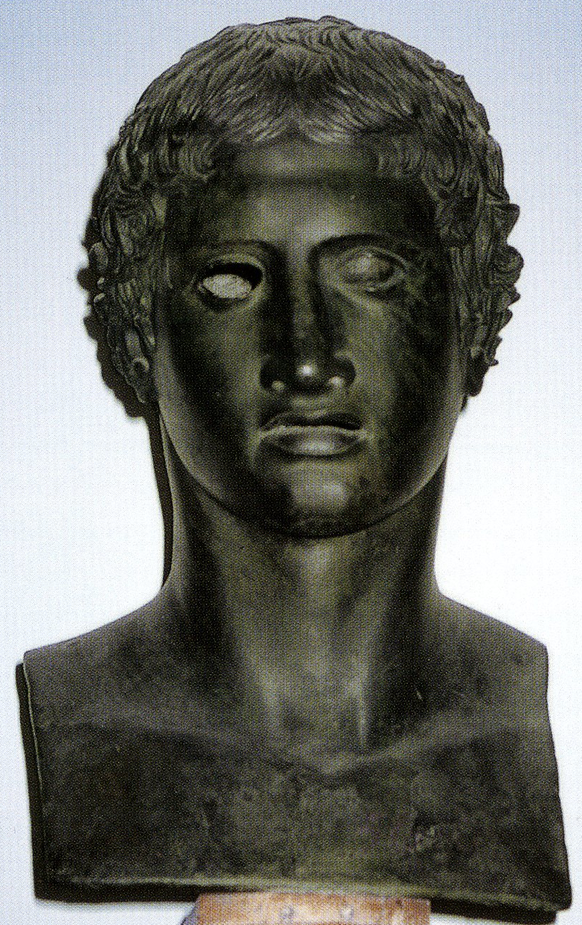
CASE STUDY 2: “THE KOUROS PISONI”
Bronze herm of the Polykleitan “Herakles” type
From the large peristyle of the Villa dei Papiri

Slide 25
CASE STUDY 2: “THE KOUROS PISONI”

Slide 26
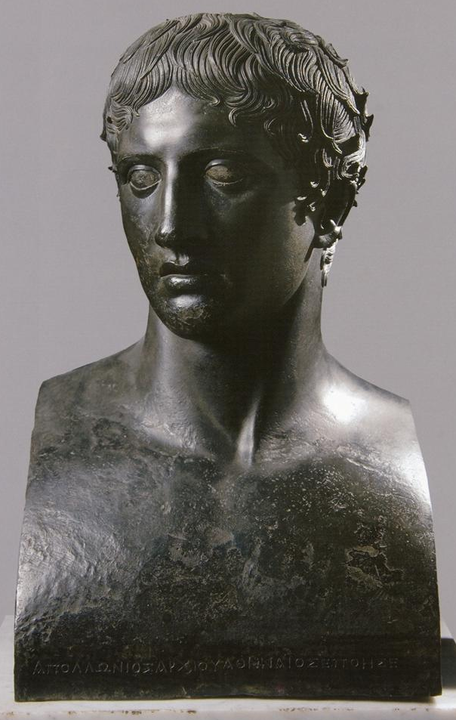
CASE STUDY 2: “THE KOUROS PISONI”
Bronze herm of the Polykleitan Doryphoros
From the small peristyle of the Villa dei Papiri

Slide 27
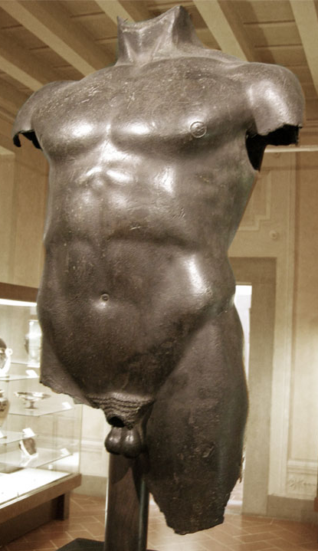
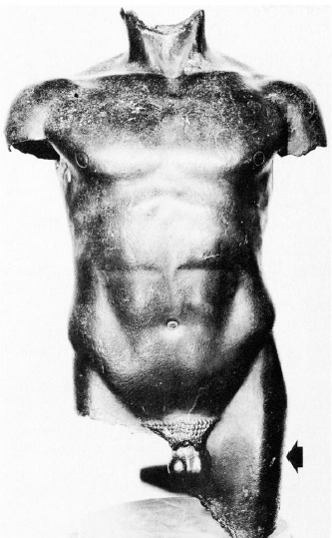
CASE STUDY 3: “THE LIVORNO TORSO”
“Torso from Livorno”: mid-1st century BC “overcast” of Early 5th century BC bronze
Florence, Archaeological Museum

Slide 28
THREE CASE STUDIES
(2)
(1)
(3)

Slide 29
THREE CASE STUDIES
…ut quidam artifices nostro faciunt saeculo, / qui pretium operibus maius inveniunt novis / si marmori adscripserunt Praxitelen suo, / detrito Myn argento, tabulae Zeuxidem. / adeo fucatae plus vetustati favet / Invidia mordax quam bonis praesentis.
Phaedrus, 5.praef.4-9
“…just as some craftsmen of our time do, who get a greater price for their works if they inscribe on a marble statue ‘Praxiteles’, or on some polished silver ‘Mys’, or on a panel painting, ‘Zeuxis’. To such an extent does carping envy favor counterfeit age over contemporary talents.”

Slide 30
THREE CASE STUDIES
(2)
(1)
(3)

Slide 31
THREE PROPOSITIONS CONCERNING TERMINOLOGY

Slide 32
THREE PROPOSITIONS CONCERNING TERMINOLOGY
we should try to speak not of “Archaistic sculptures”
but of “later works in Archaic style”

Slide 33
THREE PROPOSITIONS CONCERNING TERMINOLOGY
we should try to speak not of “Archaistic sculptures”
but of “later works in Archaic style”
(2) “later works in Archaic style” should also embrace a whole series of pieces that are currently described as “Classicistic”

Slide 34
THREE PROPOSITIONS CONCERNING TERMINOLOGY
we should try to speak not of “Archaistic sculptures”
but of “later works in Archaic style”.
(2) “later works in Archaic style” should also embrace a whole series of pieces that are currently described as “Classicistic”.
(3) A lot of works that have been termed “Archaistic” and “Classicistic” were probably always intended to be taken as genuine Archaic or Early Classical works—or reproductions of such. In other words, they are ancient forgeries.

Slide 35
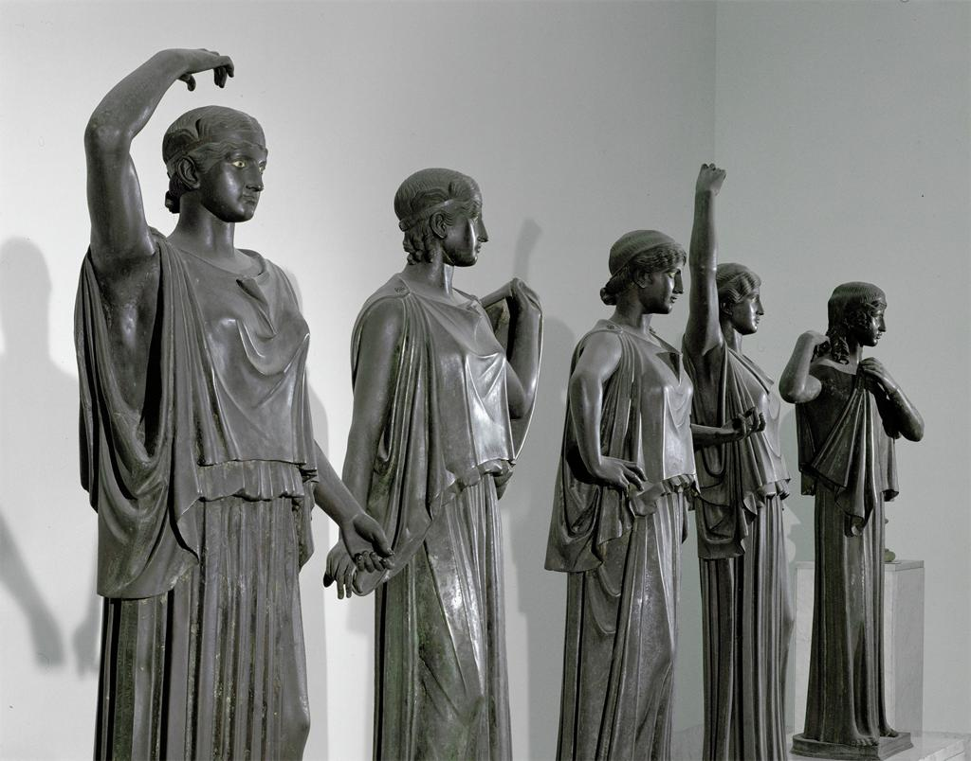
CASE STUDY 4: THE “HERCULANEUM DANCERS”
—ARCHAISTIC OR CLASSICISTIC?

Slide 36
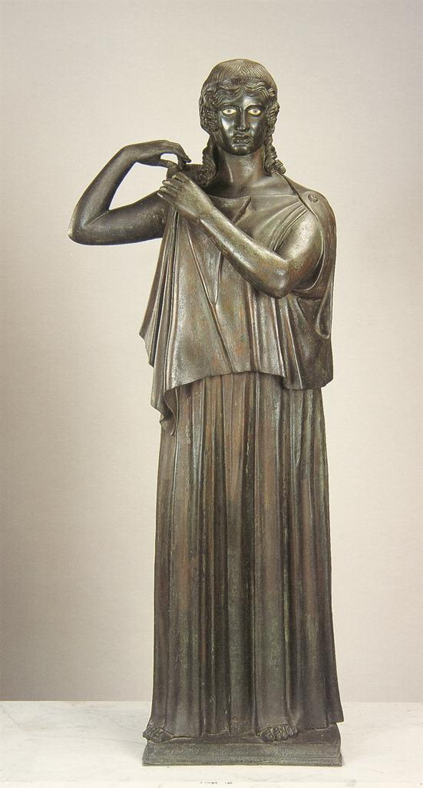
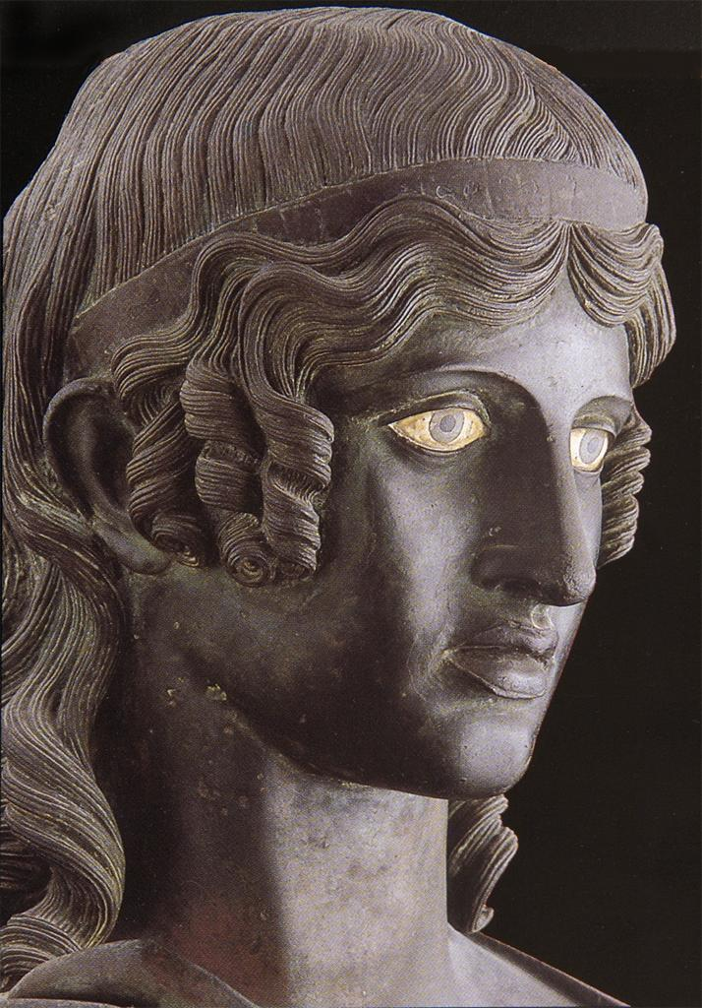
CASE STUDY 4: THE “HERCULANEUM DANCERS”
—ARCHAISTIC OR CLASSICISTIC?

Slide 37
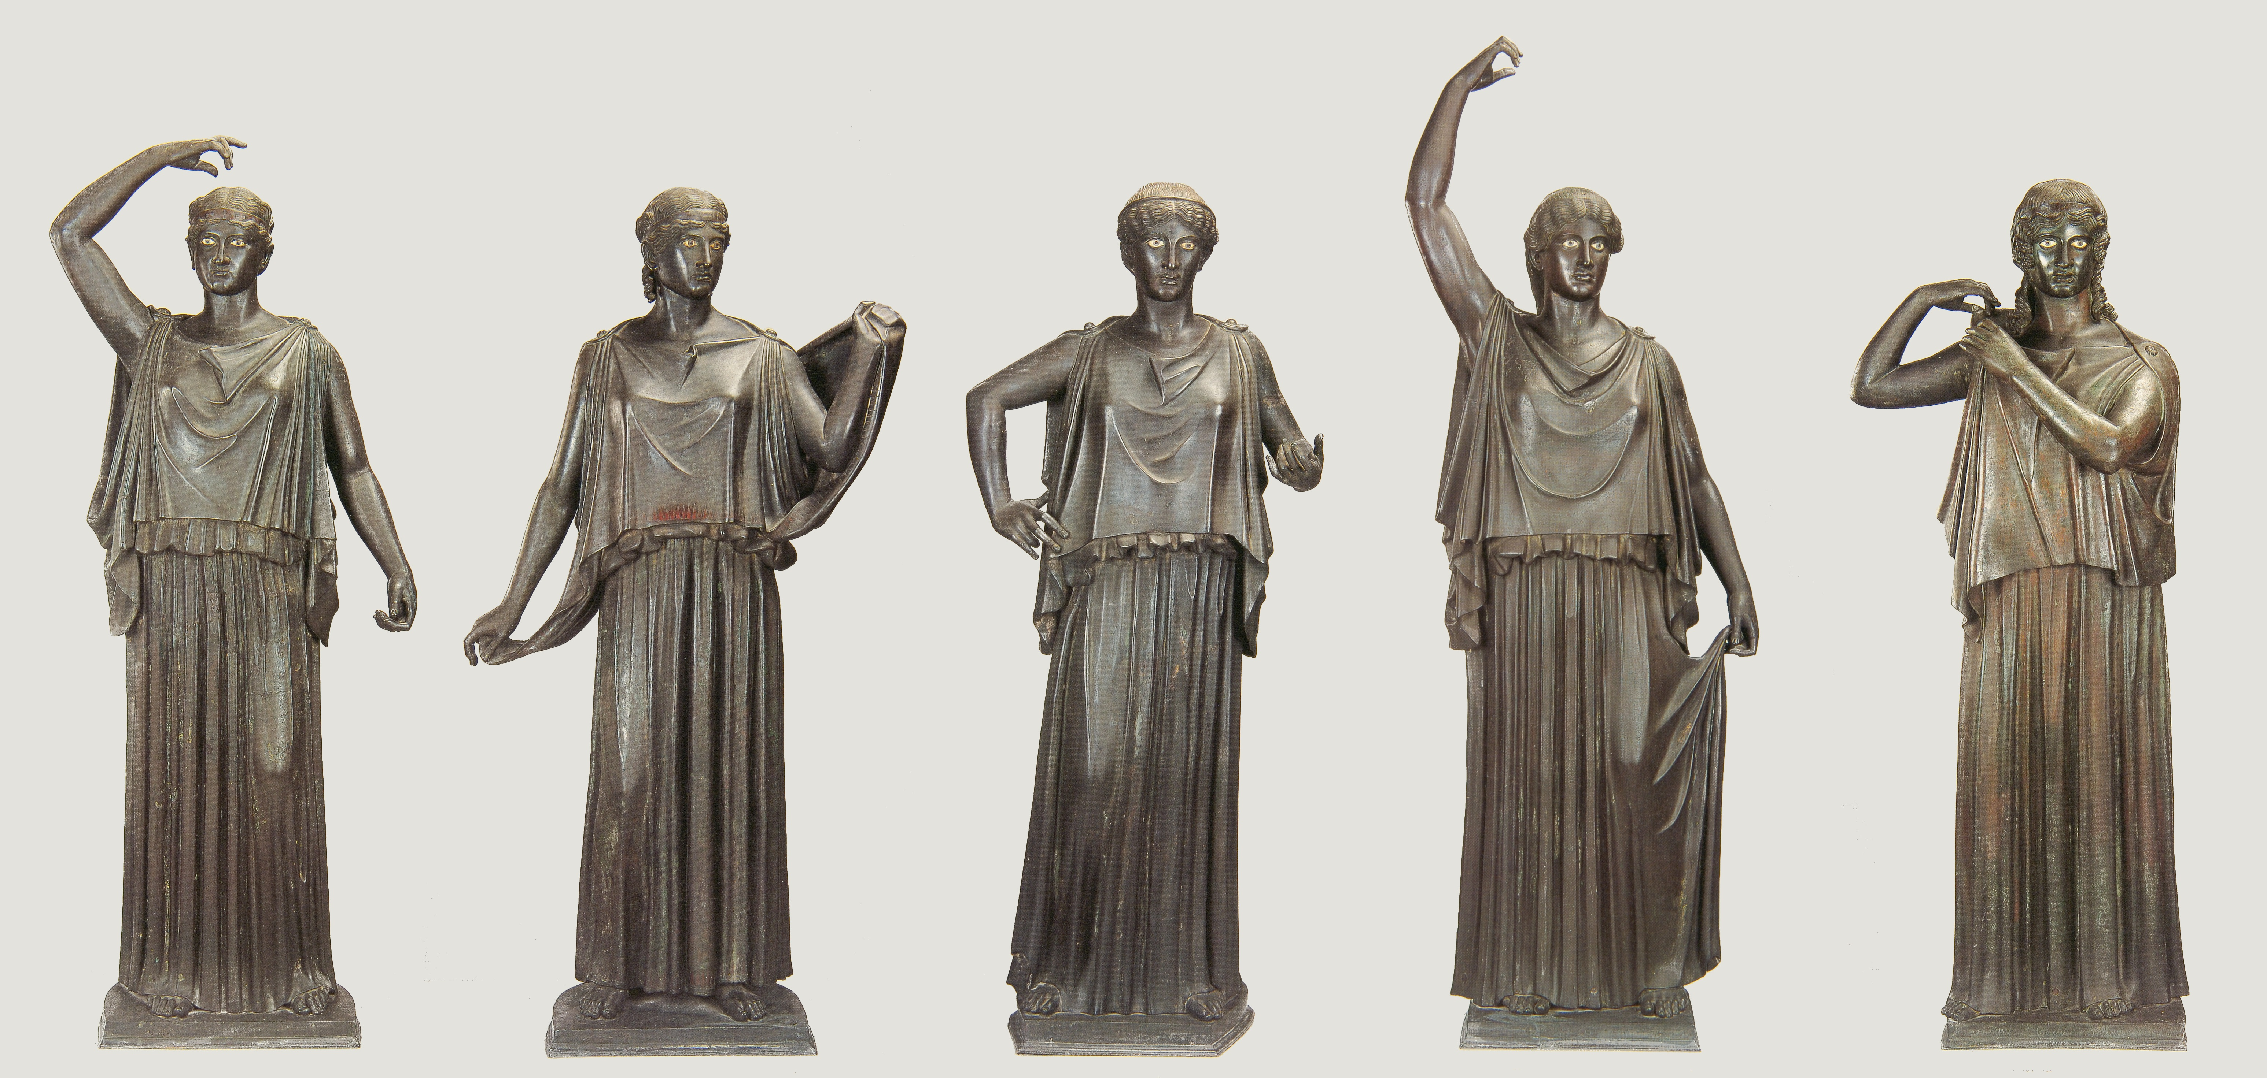
CASE STUDY 4: THE HERCULANEUM DANCERS
—ARCHAISTIC OR CLASSICISTIC?
The “Herculaneum Dancers”; five peplophoroi in Early Classical style from the Villa dei Papiri at Herculaneum; (1) woman crowning herself (?); (2) woman about to veil herself; (3) “Offering Bearer”; (4) “Water Carrier”; (5) woman pinning her peplos at the shoulder; mid-first century BC; Naples Archaeological Museum

Slide 38
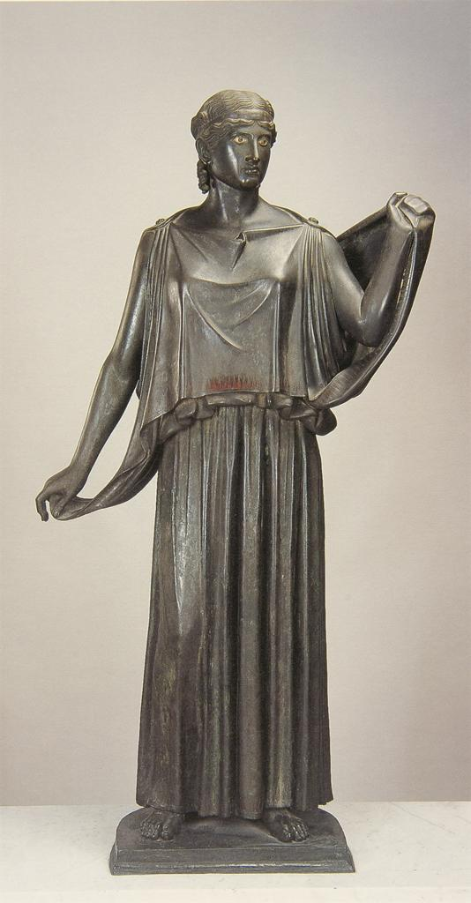
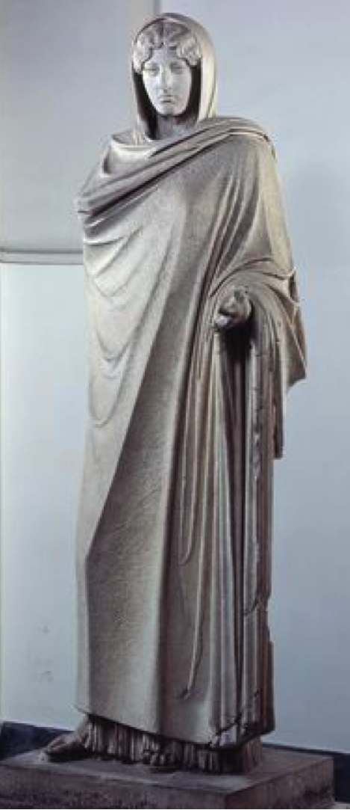
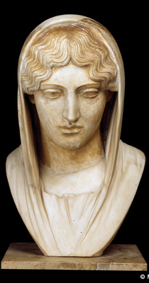
(1) THE LEVEL GAZE
Early 5th century “Aphrodite Sosandra” or “Aspasia” type, in two versions: excerpted veiled head, Louvre; full figure, from Baiae, Naples Museum.
(2) woman about to veil herself

Slide 39
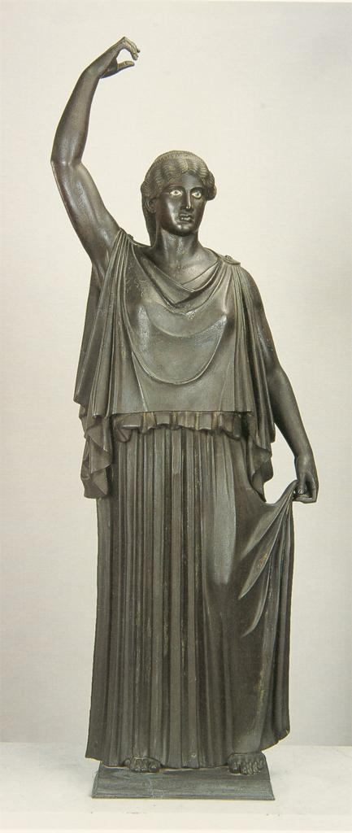
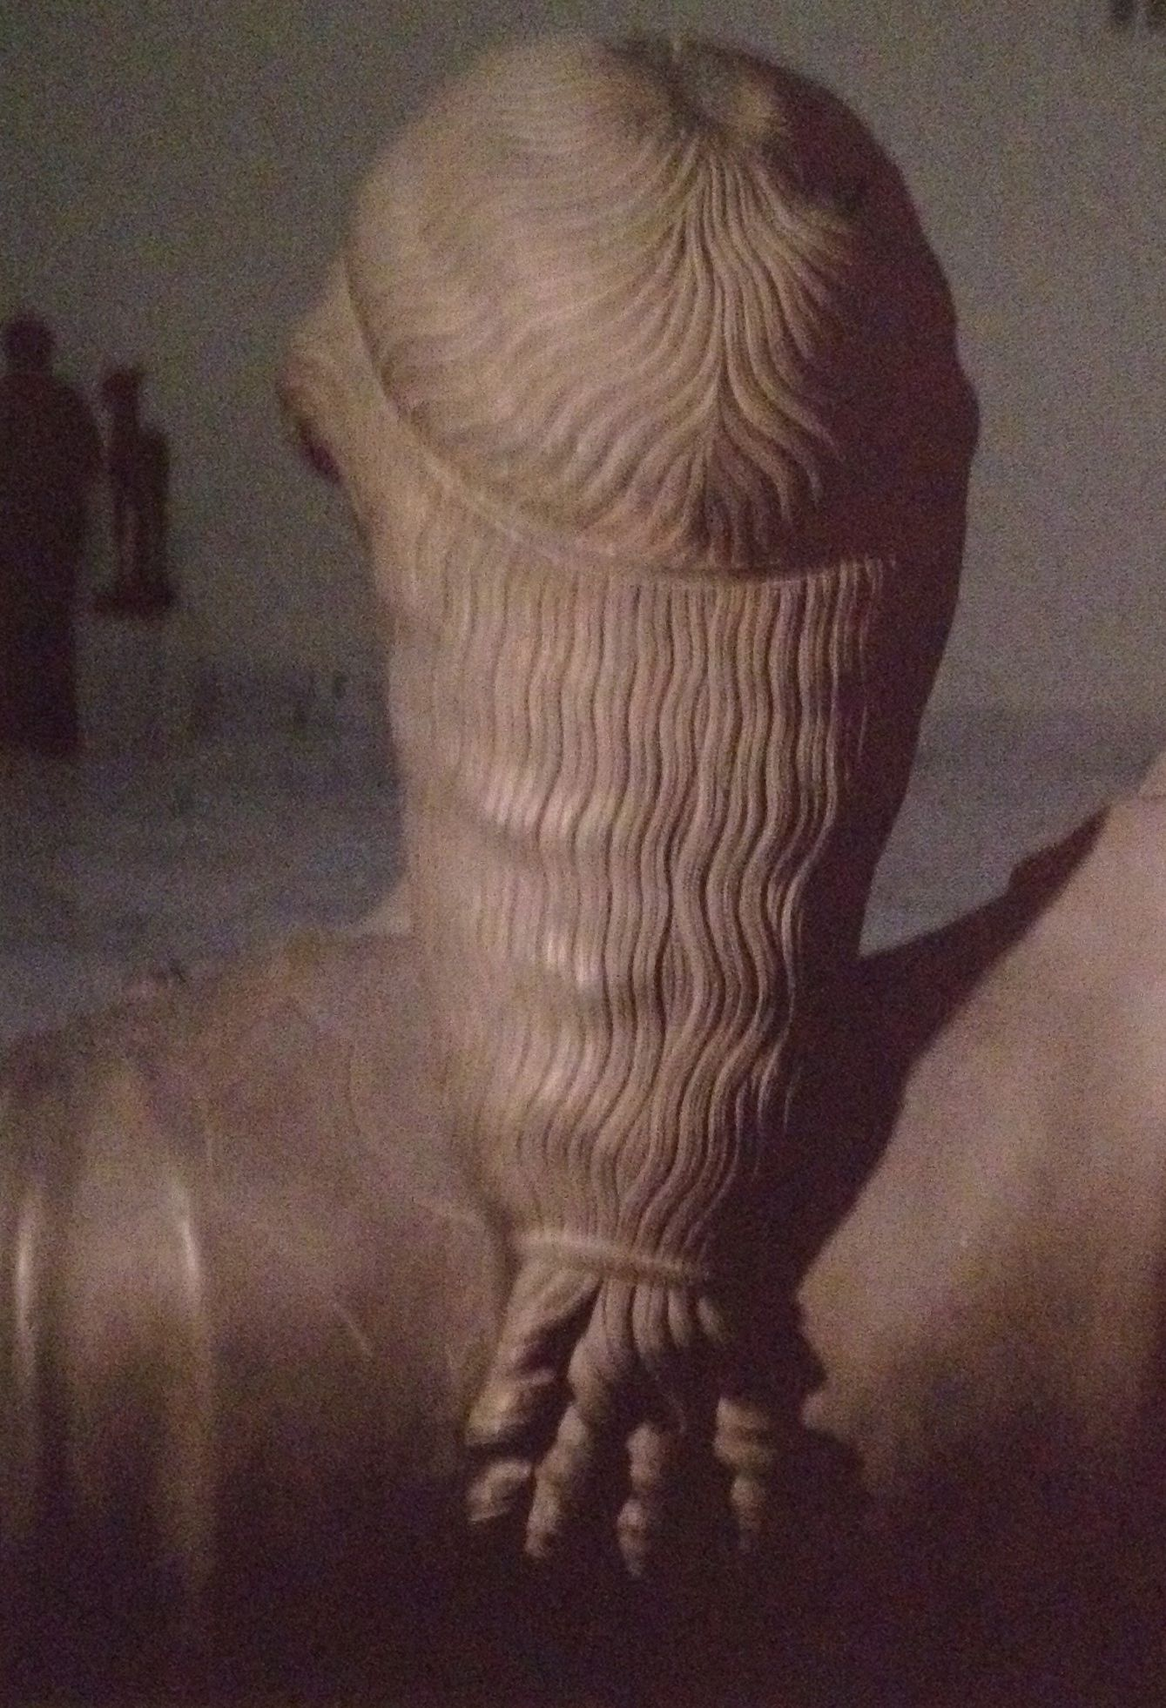
(2) THE PULLING ASIDE OF THE SKIRT, THE LONG PONYTAIL
(4) the water carrier
Detail of Archaic hairstyle

Slide 40
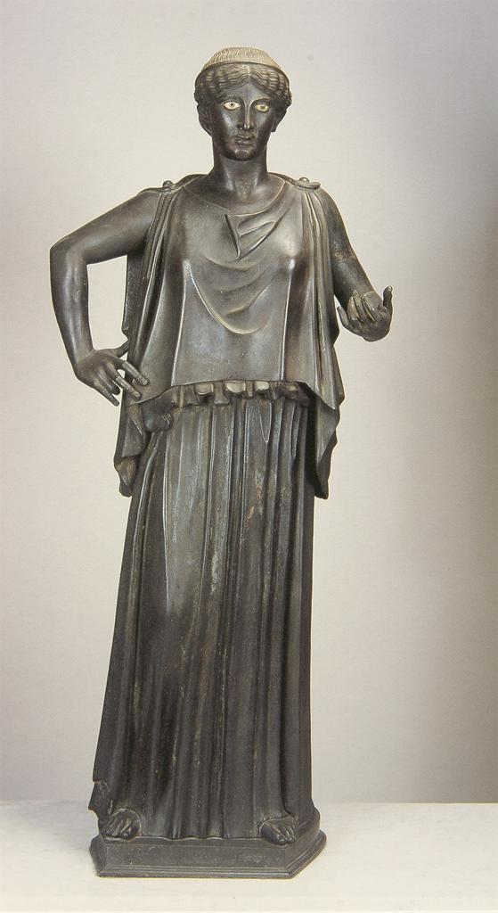
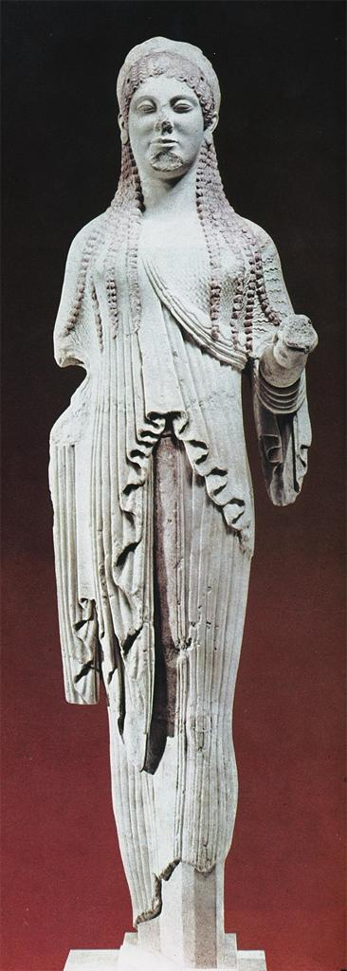
(3) THE OFFERING GESTURE
Marble Kore, ca. 500 BC
Athenian Acropolis
(3) the votive bringer

Slide 41
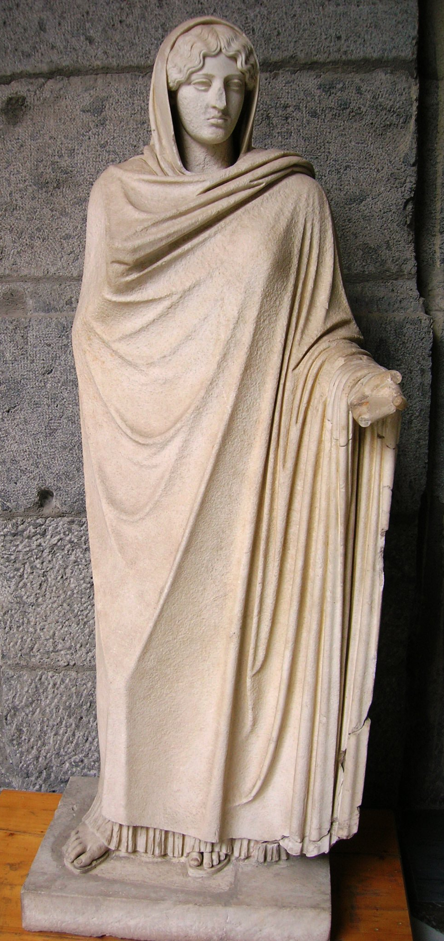
(3) THE OFFERING GESTURE
Early 5th century “Aphrodite Sosandra”
(3) the votive bringer

Slide 42
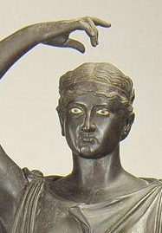
(4) THE HAND GESTURES
(2) woman about to veil herself
(5) the offering bearer
(1) woman crowning herself
(4) the water carrier
(5) woman fastening her garment

Slide 43
CASE STUDY 4: THE HERCULANEUM DANCERS
—ARCHAISTIC OR CLASSICISTIC?
The “Herculaneum Dancers”; five peplophoroi in Early Classical style from the Villa dei Papiri at Herculaneum; (1) woman crowning herself (?); (2) woman about to veil herself; (3) “Offering Bearer”; (4) “Water Carrier”; (5) woman pinning her peplos at the shoulder; mid-first century BC; Naples Archaeological Museum

Slide 44
ANCIENT RHETORICAL WRITERS ON THE EVOLUTION OF SCULPTURAL STYLE: THE “HARDNESS SCALE”
Quis enim eorum qui haec minora animadvertunt non intellegit Canachi signa rigidiora esse quam ut imitentur veritatem; Calamidis dura illa quidem, sed tamen molliora quam Canachi; nondum Myronis satis ad veritatem adducta, iam tamen quae non dubites pulchra dicere; pulchriora etiam Polycliti et iam plane perfecta, ut mihi quidem videri solent?
Cicero, Brutus 18.70
“For who among those who pay attention to the lesser arts is not aware that the statues of Kanachos are too stiff (rigidiora) to imitate natural truth? Those of Kalamis are also hard (dura), though more supple (molliora) than Kanachos’: even Myron’s have not yet fully attained true naturalness, though at that stage one would not hesitate to call them beautiful; still more beautiful are those of Polykleitos, now in my view indeed quite perfect.”

Slide 45
ANCIENT RHETORICAL WRITERS ON THE EVOLUTION OF SCULPTURAL STYLE: THE “HARDNESS SCALE”
Nam duriora et Tuscanicis proxima Callon atque Hegesias, iam minus rigida Calamis, molliora adhuc supra dictis Myron fecit. Diligentia ac decor in Polyclito supra ceteros, cui quamquam a plerisque tribuitur palma, tamen, ne nihil detrahatur, deesse pondus putant. Nam ut humanae formae decorem addiderit supra verum, ita non explevisse deorum auctoritatem videtur… At quae Polyclito defuerunt, Phidiae atque Alcameni dantur.
Quintilian, Inst. Or. 12.10.7-9
“The statues of Kallon and Hegesias are rather hard (duriora) and closest to the Etruscans’, but already Kalamis’ figures are less stiff (minus rigida), and Myron made ones that are more supple still (molliora adhuc). In precision of detail and appropriateness Polyclitus surpassed all others, but although most critics hand him the victor’s palm, to avoid making him faultless they hold that he lacks gravity. For while he gave the human body a form so appropriate that it surpassed reality, he is felt not to have done justice to the impressiveness of the gods… Nevertheless, those qualities lacking in Polyclitus are attributed to Pheidias and Alcamenes.”

Slide 46
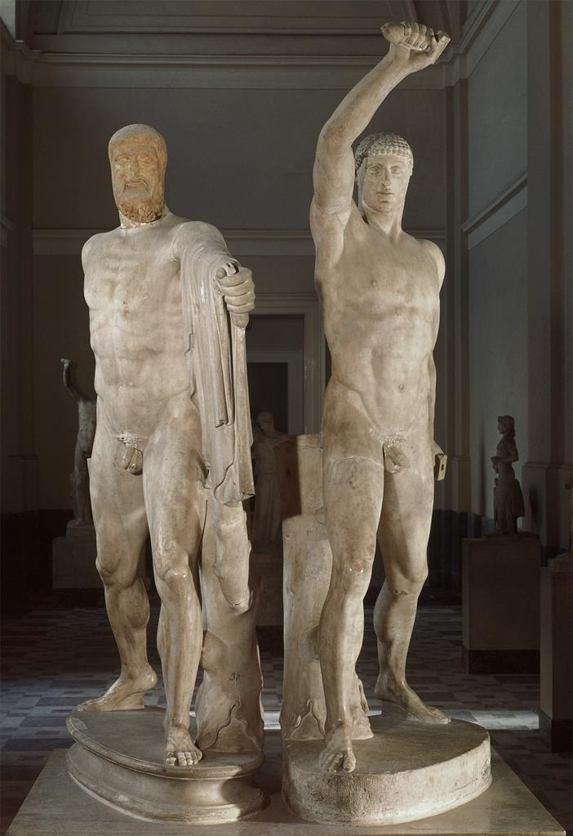
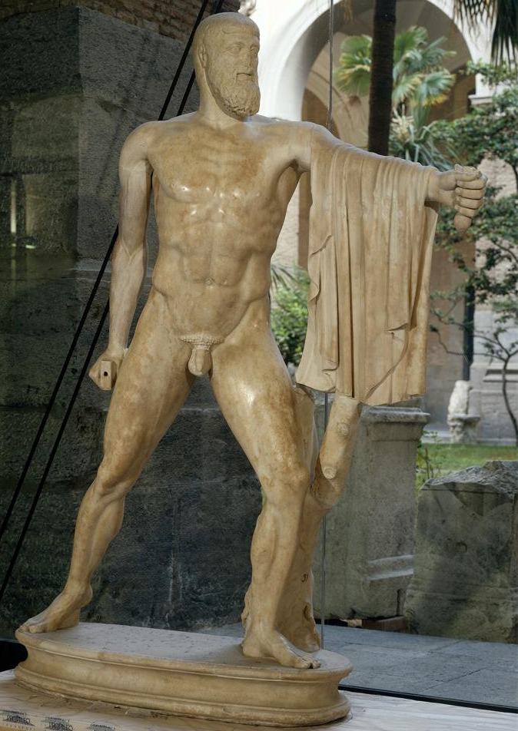
ANCIENT RHETORICAL WRITERS ON THE EVOLUTION OF SCULPTURAL STYLE: THE “HARDNESS SCALE”
The Tyrannicides of Kritias & Nesiotes, 477/6 BC

Slide 47
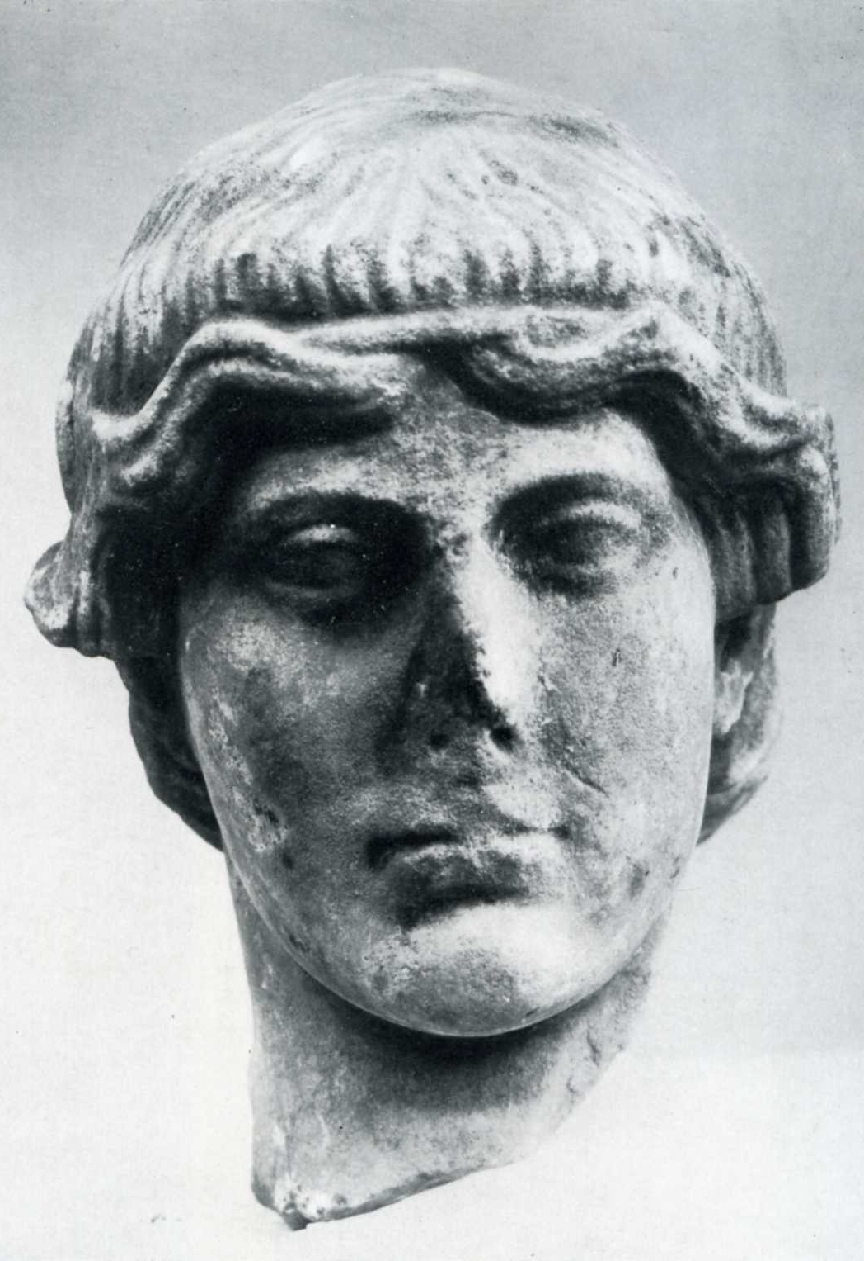
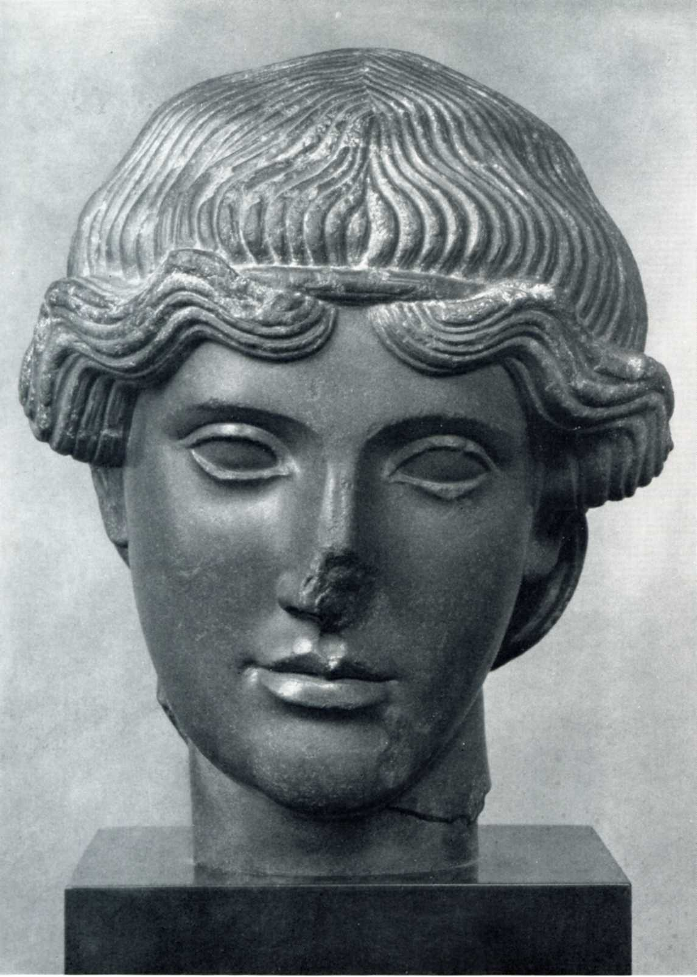
ARCHAIZING EARLY CLASSICAL BRONZES: THE “MUNICH ORPHEUS”
The “Munich Orpheus”

Slide 48
ARCHAIZING EARLY CLASSICAL BRONZES: THE “MUNICH ORPHEUS”
The Villa of the Papyri “Hermapollo”
The “Munich Orpheus”

Slide 49
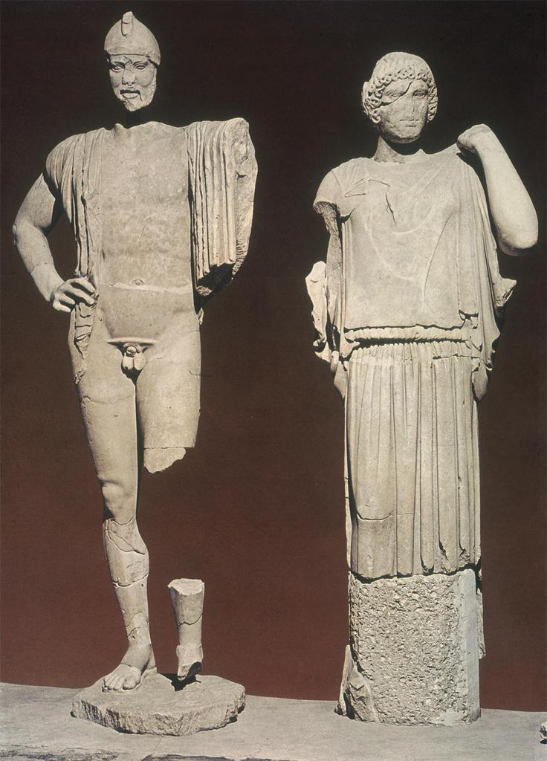
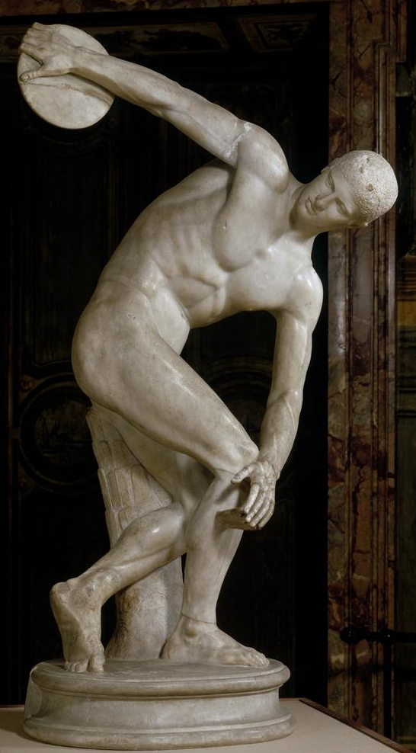
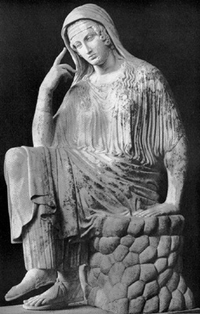
EARLY CLASSICAL POSES
Figures from the east pediment
Of the temple of Zeus at Olympia
“Seated Penelope”, Roman copy of Ealy Classical Bronze
Myron’s Diskobolos

Slide 50
ARCHAIZING EARLY CLASSICAL BRONZES
— MAKING THE “HARDNESS SCALE” VISIBLE
The “Herculaneum Dancers”; five peplophoroi in Early Classical style from the Villa dei Papiri at Herculaneum; (1) woman crowning herself (?); (2) woman about to veil herself; (3) “Offering Bearer”; (4) “Water Carrier”; (5) woman pinning her peplos at the shoulder; mid-first century BC; Naples Archaeological Museum

Slide 51
ARCHAIZING EARLY CLASSICAL BRONZES
— MAKING THE “HARDNESS SCALE” VISIBLE
(4) The “Water Carrier”
(3) The “Offering Bearer”

Slide 52
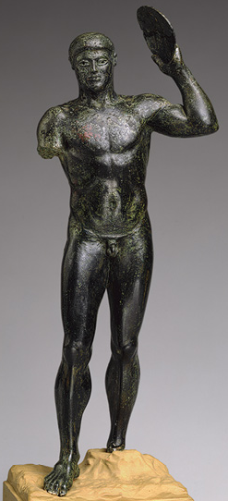
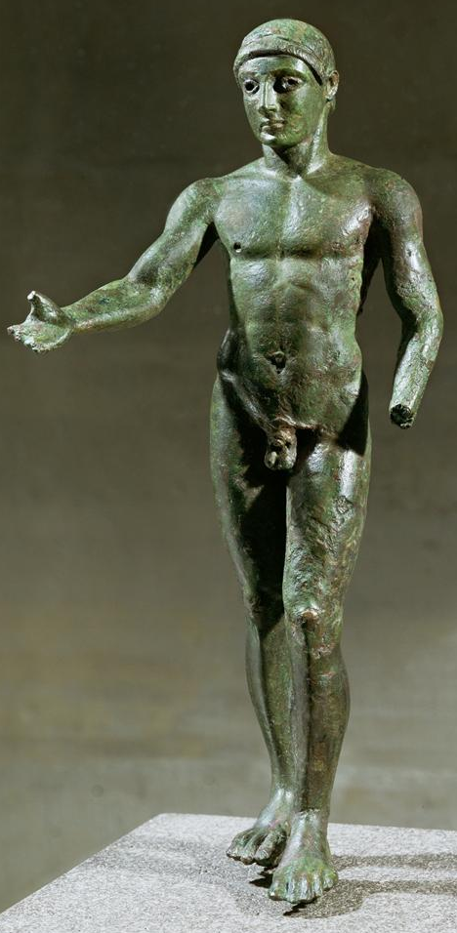
Athlete, New York, MMA
Athlete, Paris, Louvre

Slide 53

Athlete, New York, MMA
Kassel Apollo
Athlete, Paris, Louvre

Slide 54



The Fifty Daughters of Danaus, represented as hip-herms; Egyptian Basalt
From the Porticus of the Danaids, the forecourt of the Temple of Apollo Palatinus, 28 BC

Slide 55
The Fifty Daughters of Danaus, represented as hip-herms; Egyptian Basalt
From the Porticus of the Danaids, the forecourt of the Temple of Apollo Palatinus, 28 BC

Slide 56


Apollo in the Bibliotheque Nationale; 1st century BC –
1st century AD; Paris
Fig 7: Pater Liber, Naples Archaeological Museum
“Apollo from Transylvania”
1st century BC– first century AD
Vienna, Kunsthistorisches Museum

Slide 57

Fig 7: Pater Liber, Naples Archaeological Museum
“Apollo from Transylvania”; first century BC-first century AD;
Vienna, Kunsthistorisches Museum

Slide 58

CLASSICISTIC OR ARCHAIZING?
“Herm of Dionysos”, from the Villa dei Papiri, Herculaneum
mid-1st century BC; Naples Archaeological Museum

Slide 59

CLASSICISTIC OR ARCHAIZING?
“Herm of Dionysos”, from the Villa dei Papiri, Herculaneum
mid-1st century BC; Naples Archaeological Museum

Slide 60


Zeus, with crown of oak and acorns
sard intaglio; Augustan; St. Petersburg, Hermitage
Dionysos, with crown of ears of wheat and poppy capsules; sard intaglio; Augustan; Florence, Archaeological Museum

Slide 61
CLASSICISTIC OR ARCHAIZING?
“Herm of Dionysos”, from the Villa dei Papiri, Herculaneum
mid-1st century BC; Naples Archaeological Museum

Slide 62

CLASSICISTIC OR ARCHAIZING?
“Herm of Dionysos”, from the Villa dei Papiri, Herculaneum
mid-1st century BC; Naples Archaeological Museum
Marble statuette of Priapos, Private Collection

Slide 64
IN PRAISE OF FORGERY
“counterfeit age” – fucatae vetustati

Slide 65
IN PRAISE OF FORGERY
“FORGERY”–INAUTHENTICITY OF VARIOUS KINDS IN ANCIENT LITERATURE

Slide 66
IN PRAISE OF FORGERY
“FORGERY”–INAUTHENTICITY OF VARIOUS KINDS IN ANCIENT LITERATURE
1. The legendary history of early Rome, in prose and in poetry

Slide 67
IN PRAISE OF FORGERY
“FORGERY”–INAUTHENTICITY OF VARIOUS KINDS IN ANCIENT LITERATURE
1. The legendary history of early Rome, in prose and in poetry
—The early books of Livy, Dionysius of Halicarnassus, Vergil’s Aeneid
all written in the 20s BC

Slide 68
IN PRAISE OF FORGERY
“FORGERY”–INAUTHENTICITY OF VARIOUS KINDS IN ANCIENT LITERATURE
1. The legendary history of early Rome, in prose and in poetry
—The early books of Livy, Dionysius of Halicarnassus, Vergil’s Aeneid
all written in the 20s BC
2. Pre-Homeric accounts of the Trojan war

Slide 69
IN PRAISE OF FORGERY
“FORGERY”–INAUTHENTICITY OF VARIOUS KINDS IN ANCIENT LITERATURE
1. The legendary history of early Rome, in prose and in poetry
—The early books of Livy, Dionysius of Halicarnassus, Vergil’s Aeneid
all written in the 20s BC
2. Pre-Homeric accounts of the Trojan war
—Greek prose “eye-witness” accounts of the war
Dares the Phrygian, de excidio Troiae Historia (probably 1st C C.E.)
Dictys of Crete, Ephemeridos belli Troiani libri (probably 2nd C C.E.)

Slide 70


IN PRAISE OF FORGERY
The Doryphoros of Polykleitos: measure-for-measure bronze replica, Herculaneum; tiny intaglio carving– Getty

Slide 71
IN PRAISE OF FORGERY
Girl fastening her garment
Idolino, Florence

Slide 72
IN PRAISE OF FORGERY
Getty Athena Promachos
Kouros Pisoni

Slide 73

IN PRAISE OF FORGERY
Zeus, with crown of oak and acorns; Augustan
Bronze head from Beneventum; Augustan; Louvre

Slide 74
IN PRAISE OF FORGERY
Kouros from Pompeii
House of C. Julius Polybius, before AD 79
Dionysos or Priapos from the Villa dei Papiri
mid- 1st century BC

